Slide 1
Sports Analytic Project
Anthony Le

Slide 2
Project Description
The problem is who going to renew there ticket?
Our goal is to find who will likely to renew there ticket.
Hypothesis:
If they are in the backer club, they will likely to renew
If they have high income, they will likely to renew
If they been a ticket holder for a long time, they will likely to renew

Slide 3
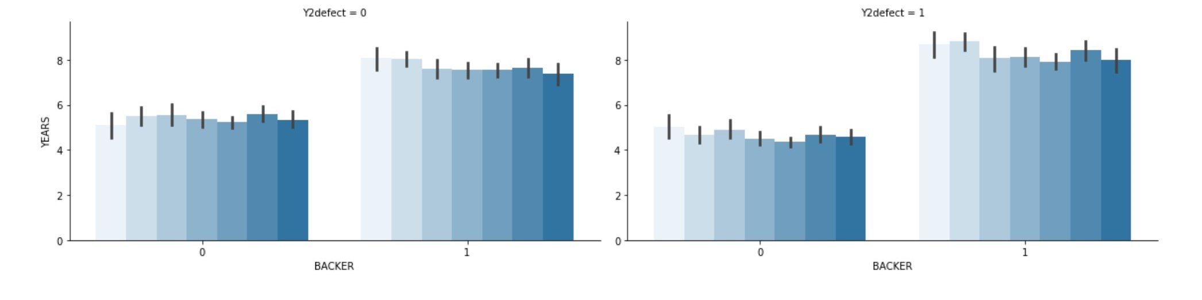
Analysis

Slide 4
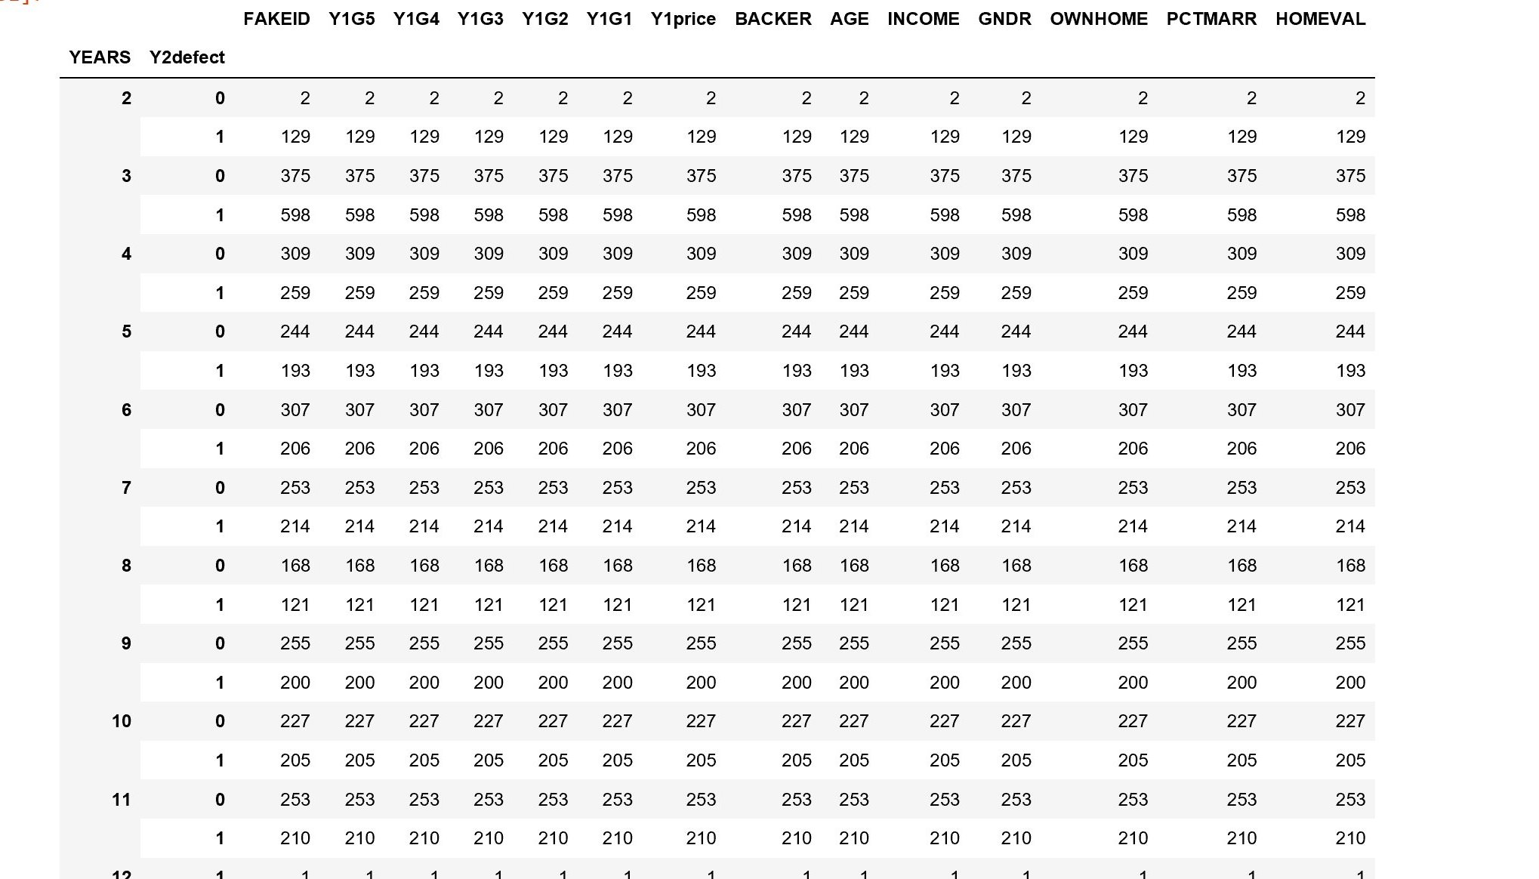

Slide 5
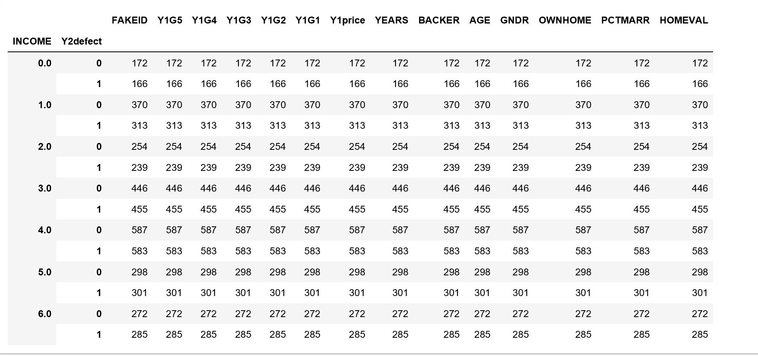

Slide 6
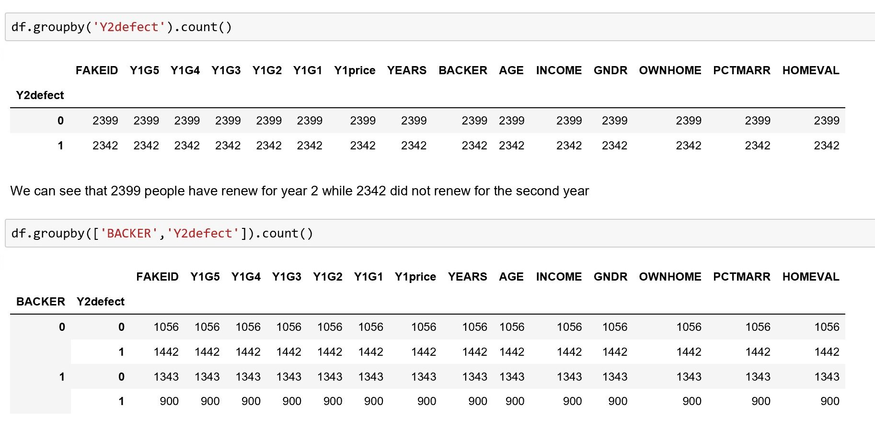

Slide 7
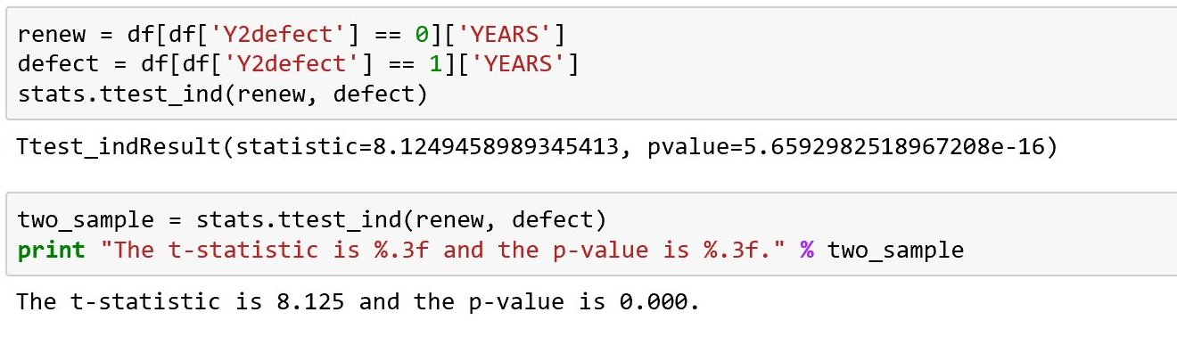
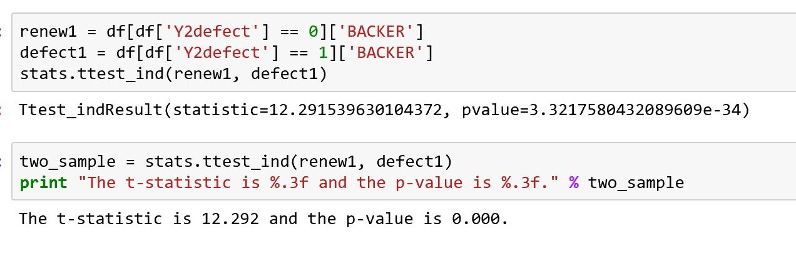
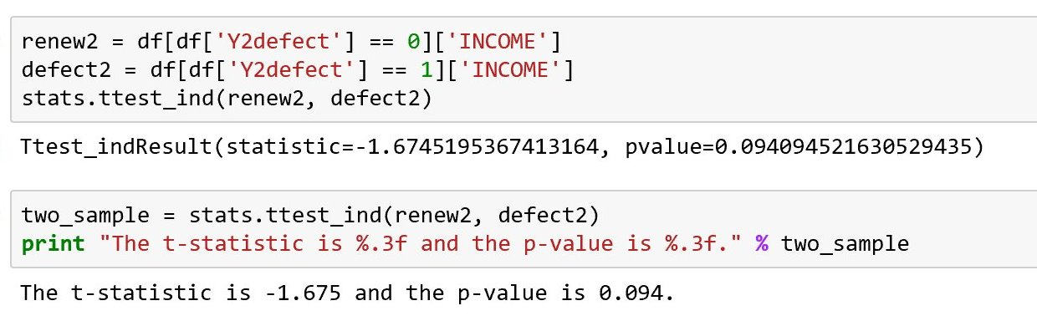

Slide 8
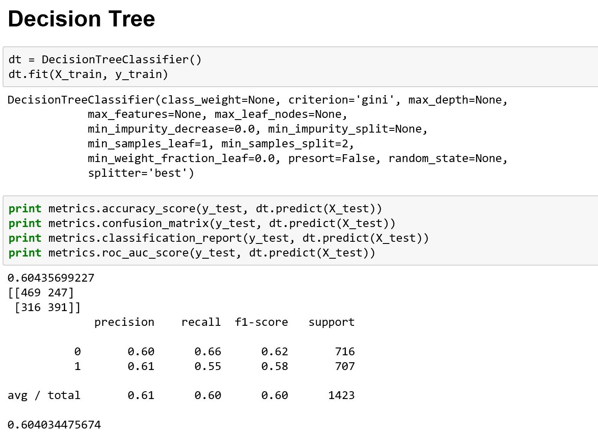

Slide 9
Storytelling
Who is likely to renew “season ticker”?
Who is likely to defect?
What actions do you recommend K-State Athletic Department (or other sports teams) to take?
What additional variables would you need to improve the model prediction?
Any other suggestions

